Slide 1
Simple and compound interest
S.I. and C.I.
Basic formulas and percentage approach

Slide 2
Interest
Interest is an additional amount that a person gets against investment of capital. Interest earnings can be of two types: Simple interest (SI) and Compound interest (CI). Let us look at and understand both of them.
Interest is if 2 types-
1. Simple interest
2. Compound interest
For both type of interest, the amount payable after t years is
A = P + Interest

Slide 3
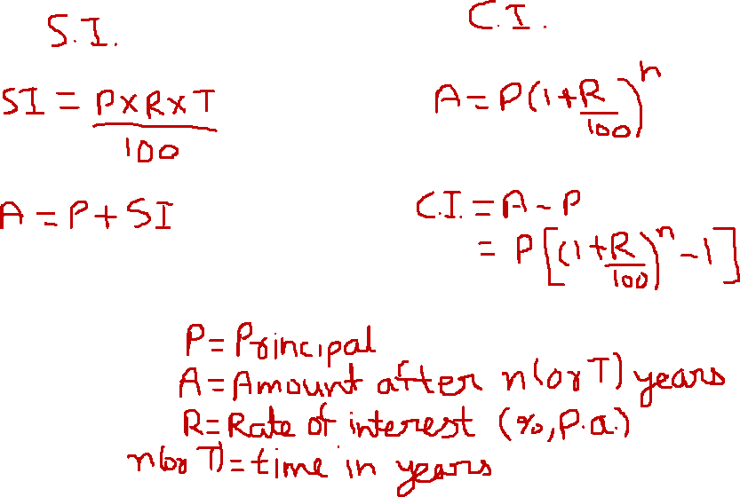

Slide 4
Simple Interest
The basic formula for Simple interest is
1. SI = (P x R x T)/100
where P is the Principal, R is the rate % and T is the time period of investment.
2. A = P + S.I.
A = P(1+ R x T)/100

Slide 5
Compound Interest
Compound interest is calculated on the principal amount and also on the accumulated interest of previous periods. This compounding effect can make a big difference to the total interest payable on a loan.
The following basic formula is used for calculating Compound interest. The formula calculates the amount, using which the interest can be calculated, that is
1. A = P {1+ (R/100)}^{n}
where A is the amount, P is the Principal, R is the rate % applicable and n is the number of periods.
2. C.I. = A - P
C.I. = P [{1+ (R/100)}^{n}-1]

Slide 6
Effective rate of interest
Compound Interest calculation if interest is payable more than once a year
Effective rate of interest = It is the interest received for 1 year if period of compounding is not 1 year (check next slide)
If interest is paid half-yearly,
A = P {1+ (R/100 p)}^{np}
Where p = no. of times interest is paid in 1 year & n is no. of years. So, if interest is paid semi-annually, quarterly or monthly, the value of p is 2, 4 & 12 respectively.
Please check next slide for better understanding of calculation of effective rate of interest by percentage method

Slide 7
Use of percentage
We can find interest as % of Principal amount and then can use equation A = P + Interest to find the total amount
Simple interest- It can be calculated by simple algebraic calculation
For example if rate of interest is 12% per annum
Then S.I. for 1 month is 1%, for 3 month is 3%, for 2 years = 24% and for 3 years = 36% and so on
Compound interest – It can be calculated by using successive % change formula
For example if R = 10 % per annum. Then interest for 2 years = 10%, 10%
By calculating c if a=b=10
C = a + b + ab/100
So, net C.I. for 2 years is c and c = 10 + 10 + (10×10)/100 = 21
So, total C.I. for 2 years is 21%
Effective rate of interest by % - It can also be calculated by applying successive % change formula
For example, What is the effective rate of interest if R = 40% per annum compounded half yearly
It is like 2 successive changes of 20%
In this case the effective rate of interest is c% where
C = a + b + ab/100 = 20 + 20 + (20×20)/100 = 44
So, effective rate of interest in this case is 44%

Slide 8
Formula vs % method
Q1 : Find the difference between the Simple Interest and Compound Interest on Rs.5000 at 20% per annum compounded half yearly for 18 Months?
Rs.105 b. Rs. 130 c. Rs.65 d. Rs.155

Slide 9
Formula vs % method
Q1 : Find the difference between the Simple Interest and Compound Interest on Rs.5000 at 20% per annum compounded half yearly for 18 Months?
Rs.105 b. Rs. 130 c. Rs.65 d. Rs.155
Solution-
a.Try to solve by formulas yourself
b. By using Percentage:
S.I. = 20% p.a. and so for 18 months = 1.5 year
S.I. = 30% of P
C.I. = 20% per annum compounded half yearly for 18 Months is equivalent to 3 successive changes of 10% each
10%, 10%, 10%
By using successive changes formula
C.I. = 33.1% of P
So, C.I. – S.I. = 3.1 % of P = 3.1% of 5000 = Rs. 155

Slide 10
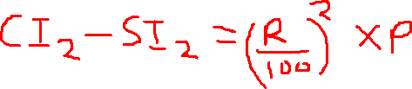
Types of problems- Difference b/w S.I. and C.I. for 2 or 3 years

Slide 11
Q1 : The difference between the SI and CI on a Sum of Rs.400000 at R% per annum for 2 years is Rs.1000. What is the value of R?
10% b. 5% c. 8% d. 12%
Q2 : The difference between the SI and the CI on a certain sum of money at 10% per annum for 3 years is Rs.620/-. Find the Principal?
20000 b. 2000 c. 10000 d. 1000

Slide 12
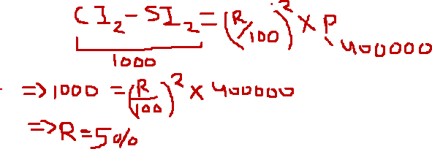
Q1 : The difference between the SI and CI on a Sum of Rs.400000 at R% per annum for 2 years is Rs.1000. What is the value of R?
10% b. 5% c. 8% d. 12%
Solution 1:
Q2 : The difference between the SI and the CI on a certain sum of money at 10% per annum for 3 years is Rs.620/-. Find the Principal?
20000 b. 2000 c. 10000 d. 1000
Solution 2:
S.I. = 10% p.a. for 3 years
S.I. (3 years) = 30% of P
C.I. = 10% per annum for 3 years is equivalent to 3 successive changes of 10% each
10%, 10%, 10%
By using successive changes formula
C.I.(3 years) = 33.1% of P
So, C.I. – S.I. = 3.1 % of P = 620
3.1% of P = 620
Solving it, P = Rs. 20000

Slide 13
Types of problems- C.I. based
Q1 : A certain sum of money becomes 3 times itself in 5 years at CI. In how many years will it become 27 times itself?
45 years b. 65 years c. 25 years d. 15 years
Q2 : A certain sum of money becomes 3 times itself in 7 years at CI. In 21 years, the same amount will become how many times it’s original value?
9 times b. 10 times c. 27 times d. 15 times

Slide 14
Types of problems- C.I. based
Q1 : A certain sum of money becomes 3 times itself in 5 years at CI. In how many years will it become 27 times itself?
45 years b. 65 years c. 25 years d. 15 years
Solution 1: A (5 years) = 3 P
So, A (10 years) = 3 (3P) = 9P
A (15 years) = 3 (9P) = 27 P
Hence, in 15 years, the initial sum of money (i.e. P) will become 27 times of itself
Q2 : A certain sum of money becomes 3 times itself in 7 years at CI. In 21 years, the same amount will become how many times it’s original value?
9 times b. 10 times c. 27 times d. 15 times
Solution 2: A (7 years) = 3 P
So, A (14 years) = 3 (3P) = 9P
A (21 years) = 3 (9P) = 27 P
Hence, in 21 years, the initial sum of money (i.e. P) will become 27 times of itself

Slide 15


Types of problems- C.I. based (formula)
In Compound Interest we can earn interest over interest. So, the C.I. earned for any specific year is equal to addition of last year’s interest and the interest earned over it.
For example,
Hence, the C.I. earned in 6th year is equal to addition of C.I. earned in 5th year and the interest earned over C.I. earned in 5th year

Slide 16
Example
Q : If the CI in the 8th year is Rs.750 and Rs. 840 in the 9th year. Find the interest received at the same rate on a Principal of Rs.2000 in the 2nd year?
Rs. 268.8 b. Rs.240 c. Rs.242.8 d. None of These

Slide 17
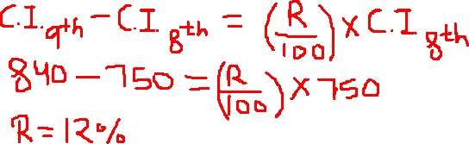
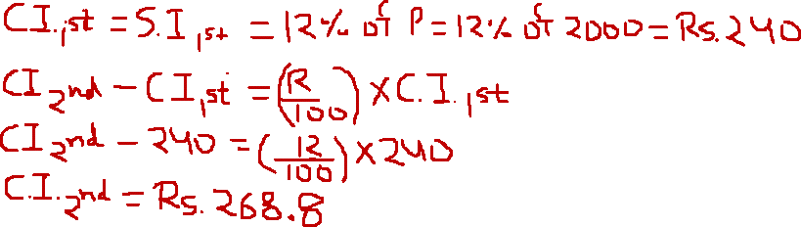

Example
Q : If the CI in the 8th year is Rs.750 and Rs. 840 in the 9th year. Find the interest received at the same rate on a Principal of Rs.2000 in the 2nd year?
Rs. 268.8 b. Rs.240 c. Rs.242.8 d. None of These
Solution:
So, The rate of interest is 12% and it is the same interest applicable to the 2nd case with P = Rs. 2000. Now, we need to find C.I.

Slide 18
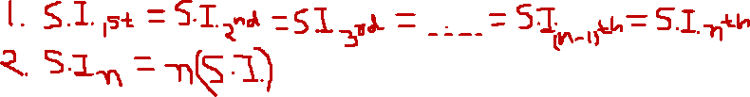
Types of problems- S.I. based (for each year S.I. remain same)
2 important points to remember in such problems-
AS, S.I. remains same for each year and hence, the S.I. for n years is n times the S.I. for a year (which remains same for each year)
Q6 : If a certain sum of money becomes 4 times itself in 8 years at SI, in how many years will it become 28 times itself?
56 years b. 50 years c. 72 years d. 80 years
Q18 : A certain sum of money becomes 6 times itself in 7 years at SI. In 42 years the same amount will become how many times it’s original value?
36 times b. 30 times c. 25 times d. None of These

Slide 19
Types of problems- S.I. based (for each year S.I. remain same)
Q1 : If a certain sum of money becomes 4 times itself in 8 years at SI, in how many years will it become 28 times itself?
56 years b. 50 years c. 72 years d. 80 years
Q2 : A certain sum of money becomes 6 times itself in 7 years at SI. In 42 years the same amount will become how many times it’s original value?
36 times b. 30 times c. 25 times d. None of These
Approach to solve such problems-
We need to use A = P + I in the 1st scenario given to us
A = P + S.I. for n years = P + n S.I.
Then, express S.I. in terms of P and use this value in 2nd scenario

Slide 20
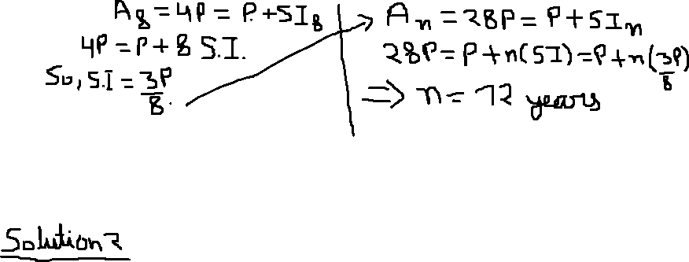
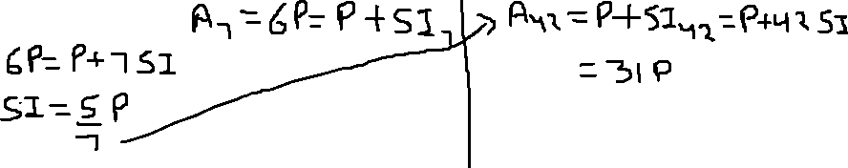
Types of problems- S.I. based (for each year S.I. remain same)
Q1 : If a certain sum of money becomes 4 times itself in 8 years at SI, in how many years will it become 28 times itself?
56 years b. 50 years c. 72 years d. 80 years
Solution 1
Q2 : A certain sum of money becomes 6 times itself in 7 years at SI. In 42 years the same amount will become how many times it’s original value?
36 times b. 30 times c. 25 times d. None of These

Slide 21
Loan repayment
If S.I. or C.I. is not mentioned clearly, assume it to be C.I.
Use concept of time value of money to solve such problems
So, the amount borrowed, and amount returned must be same at the last point of time.
Please check solutions for better understanding
Q1 : A person took a loan of Rs.3500 from his friend and agreed to pay it back with 4% SI per annum at the end of 4 years. At the end of 2 years, he returned an amount of Rs.3000. What is the additional amount to be paid to be clear of the debt at the end of 4 years?
a. Rs.140 b. Rs.500 c. Rs.640 d. None of these
Q2 : A man took a loan of Rs. 5000 to be paid back at the end of 2 years. If the rate of interest is 10% per annum and he has to pay in 2 equal annual installments, find the value of each installment?
a. Rs.3025 b. Rs.2881 c. Rs.2750 d. Rs.2550
Q3 : A man took a loan of Rs.2000 CI to be paid back in 3 equal annual installments at 10% per annum. What will be the approximate value of each Annual Installment?
830 b. 900 c. 800 d. none of these

Slide 22
Loan repayment (S.I.)
Q1 : A person took a loan of Rs.3500 from his friend and agreed to pay it back with 4% SI per annum at the end of 4 years. At the end of 2 years, he returned an amount of Rs.3000. What is the additional amount to be paid to be clear of the debt at the end of 4 years?
a. Rs.140 b. Rs.500 c. Rs.640 d. None of these
Solution 1 - next slide

Slide 23

Loan repayment (S.I.)
Q1 : A person took a loan of Rs.3500 from his friend and agreed to pay it back with 4% SI per annum at the end of 4 years. At the end of 2 years, he returned an amount of Rs.3000. What is the additional amount to be paid to be clear of the debt at the end of 4 years?
a. Rs.140 b. Rs.500 c. Rs.640 d. None of these
Solution 1
We can here that, Rs. 3500 were borrowed in 2021 at 4% p.a. interest (S.I.). Rs. 3000 were returned 2 years later (in 2023) and we need to find the amount to be paid in 2025.
In this case we will find the value of Rs. 3500 (the borrowed amount) and Rs. 3000 (repaid in 2023) in 2025 by applying the S.I. of 4% p.a. and then we will equate the borrowed and returned amounts.
Rs. 3500 of 2021 in 2025 = 1.16 × 3500 (with 4% p.a. S.I., the total S.I. in 4 years is 16%)
Rs. 3000 of 2023 in 2025 = 1.08 × 3000 (with 4% p.a. S.I., the total S.I. in 2 years is 8%)
Rs. X is in 2025 and so this value will remain as it is
Hence,
1.16 × 3500 = 1.08 × 3000 + x
Solving it, x = Rs. 820

Slide 24
Loan repayment (C.I.)
If S.I. or C.I. is not mentioned clearly, assume it to be C.I.
Use concept of time value of money to solve such problems
Q2 : A man took a loan of Rs. 5000 to be paid back at the end of 2 years. If the rate of interest is 10% per annum and he has to pay in 2 equal annual installments, find the value of each installment?
a. Rs.3025 b. Rs.2881 c. Rs.2750 d. Rs.2550
Solution 2- Next slide
Q3 : A man took a loan of Rs.2000 CI to be paid back in 3 equal annual installments at 10% per annum. What will be the approximate value of each Annual Installment?
830 b. 900 c. 800 d. none of these

Slide 25

Loan repayment (C.I.)
Q2 : A man took a loan of Rs. 5000 to be paid back at the end of 2 years. If the rate of interest is 10% per annum and he has to pay in 2 equal annual installments, find the value of each installment?
a. Rs.3025 b. Rs.2881 c. Rs.2750 d. Rs.2550
Solution 2-
We can here that, Rs. 5000 were borrowed in 2021 at 10% p.a. interest (C.I., if not mentioned C.I. or S.I. we must assume it to be C.I.). Equal installments (X) must be p[aid in 2022 and 2023 for the repayment
In this case we will find the value of Rs. 5000 (the borrowed amount) and Rs. X (repaid in 2022) in 2023 by applying the C.I. of 10% p.a. and then we will equate the borrowed and returned amounts.
Rs. 5000 of 2021 in 2023 = 5000 (1.1)^2 = 5000 × 1.21 (with 10% p.a. C.I., the total C.I. in 2 years is 21%)
Rs. X of 2022 in 2023 = X (1.1) = 1.1 X (with 10% p.a. C.I., the total C.I. in 1 year is 10%)
Rs. X in 2023 will remain as it is
Hence,
5000 × 1.21 = 1.1 X + X = 2.1 X
Solving it, X = Rs. 2881
Q3 : A man took a loan of Rs.2000 CI to be paid back in 3 equal annual installments at 10% per annum. What will be the approximate value of each Annual Installment?
830 b. 900 c. 800 d. none of these
Solution 3- Try to solve it yourself

Slide 26
Miscellaneous
Q1 : If the SI on a sum of Rs. P at 4% per annum for 2 years is double the SI received on another sum Q at 6% per annum for 3 years, then find the relation between P and Q?
P=3Q b. P=4.5Q c. P=5.2Q d. 3P=4Q
Q2 : If the SI on a certain sum for 5 years is Rs.800, while the CI on the same sum of money at the same rate for 2 years is Rs.360, what is the Rate%?
25% b. 12.5% c. 20% d. 50%
Q3 : A person invested Rs.5000 at the rate of 6% per annum for 2 years at SI. At the end of 2 years, he took the entire amount alongwith interest and invested in another scheme offering 10% CI for 2 years. What is the total amount received at the end of 4 years?
Rs.6560 b. Rs.6600 c. Rs.6686 d. None of These

Slide 27
Miscellaneous
Q4 : The population of a town grows annually at the rate of 5% per annum. If the present population is 9261000, find the population of the town 3 years ago?
800000 b. 900000 c. 8000000 d. None of These
Hint- Let the population 3 years ago = P
Population today = P (1 + 5/100)^3 = P(1.05)^3 = 9261000
So, P × 1.05 × 1.05 × 1.05 = 9261000
P × (21/20) × (21/20) × (21/20) = 9261000
P = 8000000
Q5 : A strain of bacteria doubles itself in every 15 minutes. In how much time will it become 1024 times it’s initial value?
150 minutes b. 120 minutes c. 100 minutes d. 90 minutes
Q6 : At 20% per annum Compounded interest, in how many years will an amount become 3 times it’s original value?
7 years b. 6 years c. 4 years d. 8 years

Slide 28
Important Tips
In the first period, SI and CI are equal. In all the other periods after the first period, the CI is greater than the SI.
In simple interest, the total rate of interest applicable is the sum of all the respective rates applicable.
In compound interest, the total rate of interest applicable is the successive effect of the respective rates given.
The difference between the CI and the SI at the end of two periods is because of the additional interest received on the first period’s interest in case of compound interest.
Compound interest increases each year over last year. The difference between the CI in any two consecutive periods is the additional interest received on the first period’s interest.
Simple interest remain same for each year and so S.I. for n years = n × S.I. (for 1 year)

Slide 29
Important Results
If an amount becomes N times itself in T years at SI, then the required rate of Interest = 100(N – 1)/T %
If the difference between CI and SI on a certain sum P at R% per annum for 2 years is D, then D = P (R/100)²
If the population of a town increases at the rate of R% per annum, then the population after n years = P(1 + r/100)^{n}
If the population of a town decreases at the rate of R% per annum, then the population after n years = P(1 - r/100)^{n}

